Slide 1
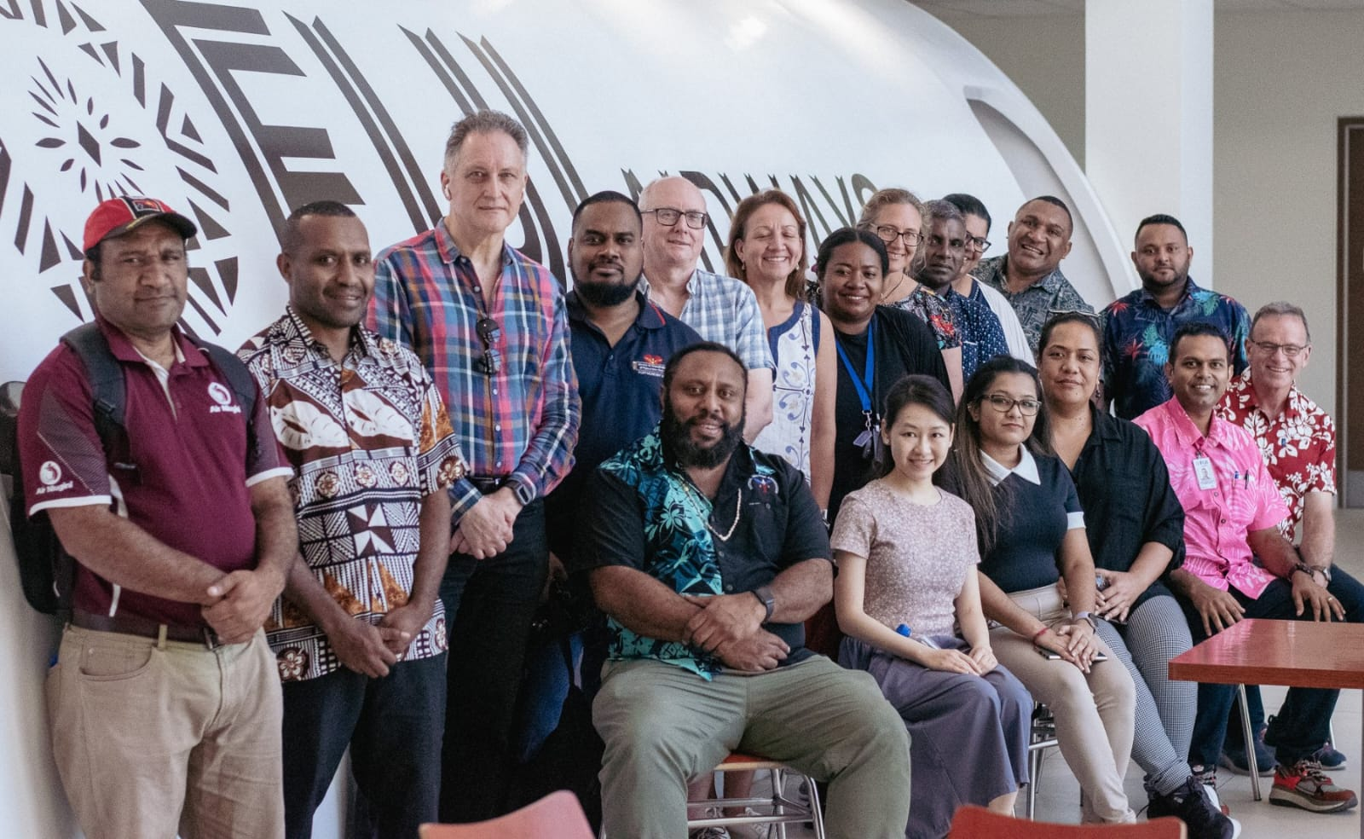
Title: Uniting for Excellence: Joining the Pacific Doctors Network
Subtitle
Leveraging WONCA Conference Insights for Regional Health Advancement
Presenter Name: Dr. KESHWAN NADAN
Date:31/07/2024

Slide 2
Introduction
The Pacific Doctors Network (PDN) stands as a vital collaborative initiative aimed at enhancing healthcare standards across the Pacific region.
Leveraging the insights and expertise gained from the World Organization of Family Doctors (WONCA) conferences, PDN seeks to foster a united front among healthcare professionals.
This paper delves into the strategic importance of PDN, the benefits of collaborative efforts, and actionable steps to create a significant impact on regional health advancement.

Slide 3
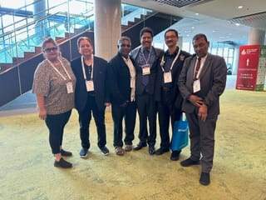
Objectives
Enhance Healthcare Workforce: Focus on local capacity building and community development to create a resilient and innovative healthcare workforce in the Pacific region.
Strengthen Partnerships: Foster collaborations with international partners to support healthcare initiatives and address challenges, particularly those highlighted during the COVID-19 crisis.
Expand WONCA Programs: Advocate for policy support and funding to sustain and expand WONCA-related programs in the Pacific.
Increase Participation: Work towards increasing the inclusion of Pacific family doctors in the WONCA Asia Pacific regional block.
Promote Multidisciplinary Collaboration: Engage with various stakeholders to enhance the provision of healthcare services across the Pacific.
Celebrate Achievements: Recognize and celebrate the successful conference and ongoing efforts to improve healthcare in the region

Slide 4
Pacific Doctors Network: Definition and Mission
The Pacific Doctors Network is a collaborative organization that connects healthcare professionals across the Pacific region.
Its primary mission is to enhance the quality and accessibility of healthcare services by fostering cooperation, sharing best practices, and leveraging collective expertise.
The network aims to address regional health challenges, promote professional development, and support healthcare innovations that are tailored to the unique needs of Pacific communities.

Slide 5
Benefits of Becoming a Part of the Pacific Doctors Network
Global Perspectives on Family Medicine
WONCA conferences bring together family medicine practitioners from around the world, offering a wealth of knowledge and diverse perspectives. PDN members can harness these insights to adapt global best practices to the local context, enhancing healthcare delivery across the Pacific
Building Professional Networks
The conferences provide an excellent opportunity for PDN members to build professional networks, fostering collaboration and mentorship. These connections are crucial for knowledge exchange, professional development, and collective problem-solving.
Access to Cutting-edge Research
WONCA conferences showcase the latest research in family medicine and primary healthcare. PDN members can access this research to inform their practice, drive local studies, and contribute to the global body of medical knowledge.

Slide 6
Importance of Collaboration for Enhancing Healthcare in the Region
Bridging Gaps in Healthcare
The Pacific region faces unique challenges, including geographic isolation, limited resources, and varying levels of healthcare infrastructure. PDN aims to bridge these gaps by providing a platform for doctors to share knowledge, resources, and best practices.
Enhancing Medical Education and Training
Through PDN, healthcare professionals have access to continuous medical education and training. This ensures that doctors in the Pacific remain updated with the latest medical advancements and techniques, ultimately improving patient care standards.
Promoting Regional Research and Development
PDN encourages collaborative research efforts to address region-specific health issues. By pooling resources and expertise, the network can drive innovative solutions and policies tailored to the Pacific context.

Slide 7
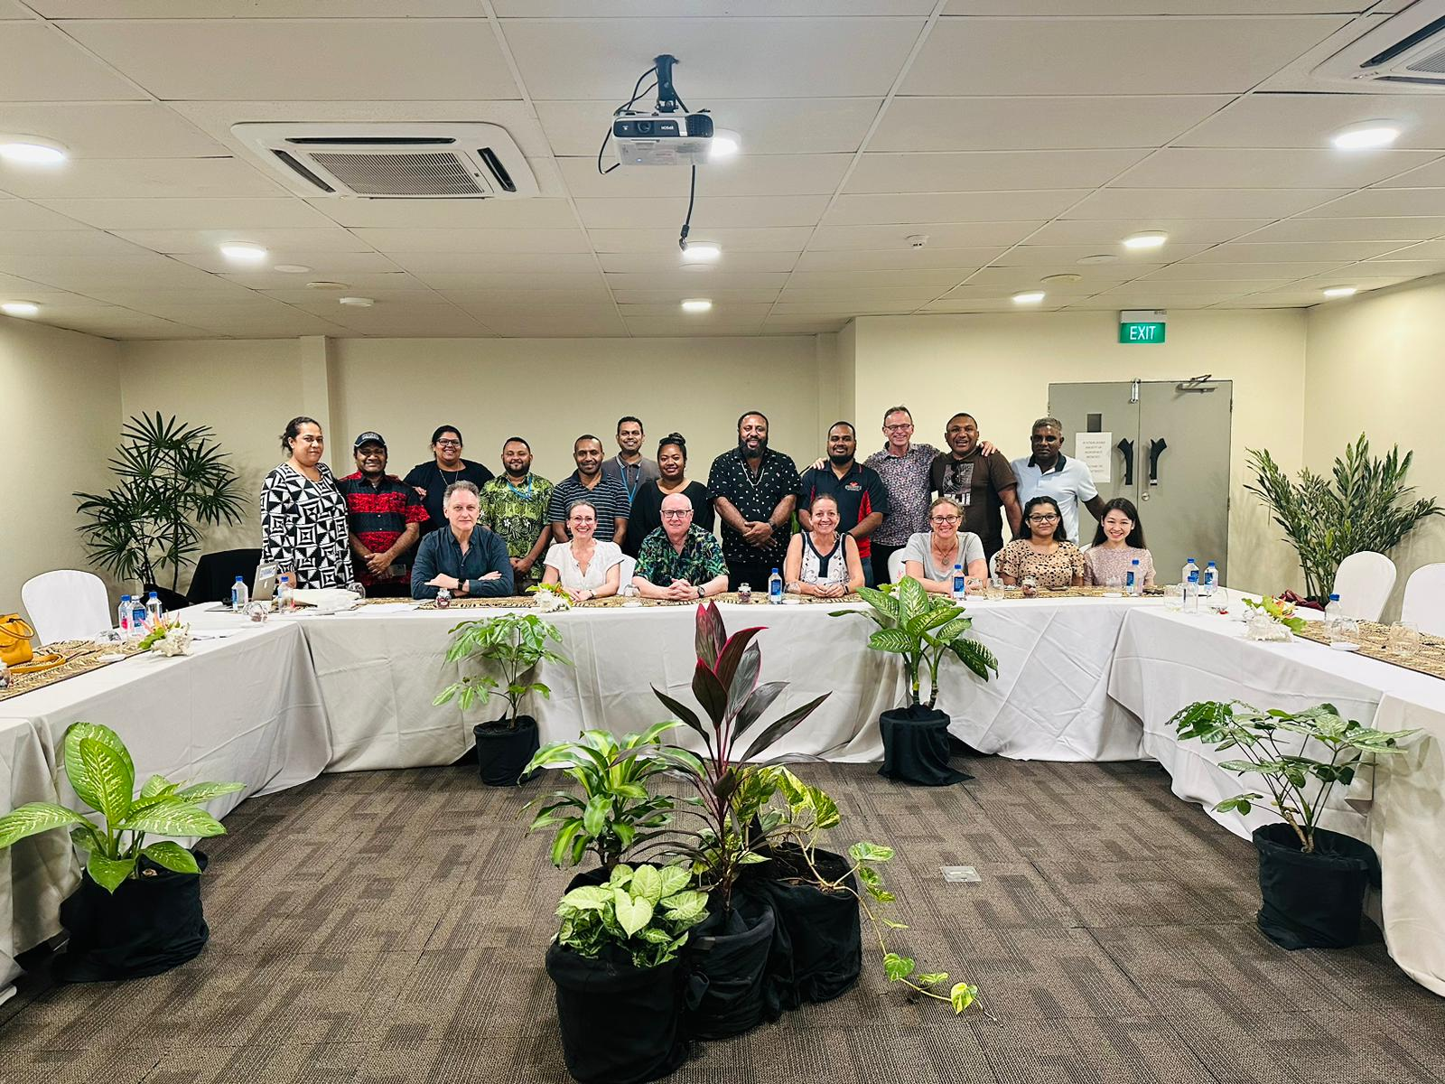
Strategies for Effective Collaboration within PDN
Establishing Communication Channels
Effective communication is the backbone of any successful network. To facilitate regular interaction among members, PDNs should leverage digital platforms, including webinars, social media, and dedicated forums.
Creating Specialized Working Groups
PDN can form specialized working groups focused on key health issues such as non-communicable diseases, maternal and child health, and infectious diseases. These groups can spearhead targeted initiatives, share expertise, and drive collaborative projects.
Hosting Regional Conferences and Workshops
In addition to participating in WONCA conferences, PDN should organize regional conferences and workshops. These events can provide a platform for members to present their work, share insights, and engage in hands-on training sessions.
Developing a Resource Sharing System
PDN should establish a centralized repository for resources, including research papers, training materials, and clinical guidelines. This system will enable members to access and contribute valuable information, fostering a culture of continuous learning.

Slide 8
WONCA Conference Insights
Global Perspectives on Family Medicine
WONCA conferences bring together family medicine practitioners from around the world, offering a wealth of knowledge and diverse perspectives. PDN members can harness these insights to adapt global best practices to the local context, enhancing healthcare delivery across the Pacific
Building Professional Networks
The conferences provide an excellent opportunity for PDN members to build professional networks, fostering collaboration and mentorship. These connections are crucial for knowledge exchange, professional development, and collective problem-solving.
Access to Cutting-edge Research
WONCA conferences showcase the latest research in family medicine and primary healthcare. PDN members can access this research to inform their practice, drive local studies, and contribute to the global body of medical knowledge.

Slide 9
WONCA Conferences
Recent WONCA conferences have highlighted several important trends and findings in family medicine and primary healthcare. These include advancements in telemedicine, the integration of mental health services into primary care, and strategies for managing chronic diseases in resource-limited settings.
By applying these insights, healthcare practitioners in the Pacific region can improve their practices and better address the unique challenges they face. For example, the adoption of telemedicine can enhance access to care for patients in remote areas, while integrated mental health services can provide more comprehensive care for patients with mental health needs.

Slide 10
WONCA Conferences
WONCA conferences
have led to positive changes in regional health outcomes. These examples will highlight the practical application of WONCA conference insights and their impact on healthcare practices in the Pacific.
Impacting Regional Health Advancement
Improving Health Outcomes
Through enhanced collaboration, PDN aims to improve health outcomes across the Pacific. By implementing evidence-based practices and innovative solutions, the network can address key health challenges and reduce disparities in healthcare delivery.
Strengthening Health Systems
PDN's collaborative efforts will strengthen health systems in the region. By advocating for policy changes, improving healthcare infrastructure, and enhancing workforce capacity, the network can drive sustainable improvements in healthcare delivery.
Fostering Community Engagement
PDN can play a crucial role in fostering community engagement and health education. By working closely with local communities, the network can promote healthy behaviors, raise awareness about preventive care, and empower individuals to take charge of their health.

Slide 11
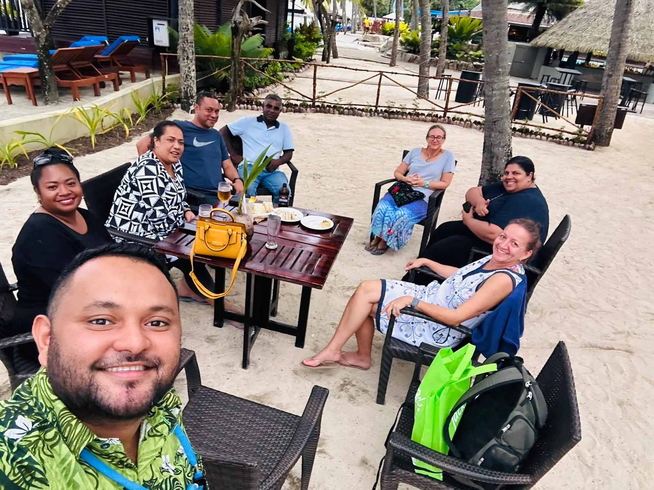
Call to Action
I would like to invite all healthcare professionals in the Pacific region to join the Pacific Doctors Network.
Together, we can harness the power of collaboration and innovation to build a brighter, healthier future for our communities.
Let us unite for excellence and make a lasting impact on regional health advancement.

Slide 12
Conclusion
The Pacific Doctors Network, leveraging insights from the WONCA conference, has immense potential to transform health care across the Pacific regions.
Through strategic collaboration, continuous education, and commitment to excellence, PDN can drive significant advancements in regional health outcomes. Together, as a unified front of dedicated healthcare professionals we can overcome challenges and create a healthier, more resilient Pacific.

Slide 13
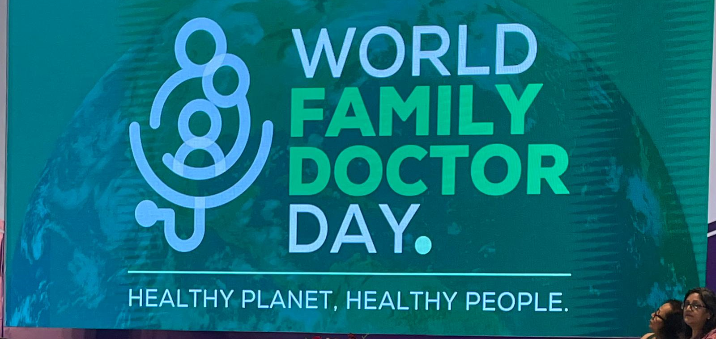

Slide 14
