Slide 1
DIGITALISATION OF PROVINCIAL DEVELOPMENT PLANS, ecommerce and smart solutions

Slide 2
Objective
The objective of this presentation is to:
Show the current direction for iTaukei Institution and communities in terms of operation and digitalization.
Invite the various organizations and stakeholders in moving the iTaukei communities forward.

Slide 3
Fiji Provincial Background
The iTaukei Affairs institutions looks after:
1173 villages (we are in the process of registering an additional 45 villages)
189 districts (tikina)
14 provinces
For the province of Rotuma, the governance or vanua aspect comes under iTaukei Affairs, whilst development comes under Ministry of Rural and Maritime Development and the Office of the Prime Minister.
The iTaukei (Fijian) Administration was founded on the 10th of October 1874.
with the appointment of the Roko Tuis to look after the administrative provinces then.
Mr Swanston was the first Secretary for Native Affairs in the then Fijian Administration.
The iTaukei Administration was reformed into the iTaukei Affairs Board in 1944 after the establishment of TLTB in 1940.

Slide 4
Village Profile Scope
Demographic Information
Economic Activities
Educational Facilities and Attainment
Health and sanitation
Infrastructure and services
Social and Cultural Aspects
Natural Resources and Environment
Governance and institutional Framework

Slide 5
Village Profile Brief
There are 46,364 households in the villages in Fiji
There are 167, 597 residents or villagers.
We have 87,697 males.
We have 79,918 females.

Slide 6
Digitilisation in the VP
For the 2023 VP survey, Taukei Affairs implemented the Computer Assisted Personal Interviewing (CAPI) system using the Survey Solution software on tablets. Each survey enumerator was equipped with a tablet, replacing the previously used paper questionnaires. They type the information in the tablet, and upon meeting the criteria of the completion, it is sent to our HQ for approval.
The Profiling was conducted using Vodafone as our choice of internet provider for the collection of data on the field in the 14 provinces and sent to HQ digitally.

Slide 7
Facts about the iTaukei
Of those living below the poverty line in Fiji, some 200,000 in fact, 75% are iTaukei.
80% of those in the Correctional Facilities are iTaukei.
Only 5% of the businesses in Fiji are iTaukei
We have just been colonized and developed in the last 100 years or so and we are still learning and growing.

Slide 8
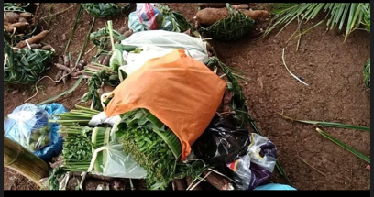
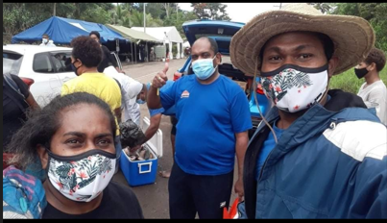
COVID SCENARIO - DIGITILISATION

Slide 9
Men working on a tanoa – Lau group

Slide 10
Indicators from VP Exercise
Our indicators show families without access to proper WASH and sanitation facilities, access to power and communication and also proper living conditions such as housing.
It also shows the following:
weak education attainment
low business acumen
most of those in villages do not have investments, bank accounts and savings.
These are some of the indicators that we will provide on the platform and what the plans are there in the Integrated Village Development Plans to address the issues.

Slide 11
iTaukei Urban area
Comparisons and analysis with National Census and our Vola ni Kawa Bula (Register of iTaukei Landowners), indicates that there are a lot of iTaukeis in the urban area than in the villages. The 2017 census shows a 45% rural and 55% Urban iTaukei. The number could be more

Slide 12
Way Forward
Develop our rural areas, make villages more attractive again.
Reverse migration
Powerful groups in iTaukei Communities

Slide 13
VINAKA VAKALEVU

