Slide 1
Men’s Sexual Health; Breaking taboo and promoting Health-seeking behavior
Addressing myths, encouraging conversations and promoting well-being
Dr Ahmed Shakeel Shariff
MBBS PGDIM PGCGP MFCGP
Founder and Director Health Masters
Executive Council Member Fiji Medical Association
Executive Fiji College of General Practitioners

Slide 2
An introduction to men's sexual health
Male sexual health refers to the overall well-being of men in relation to their sexual function, performance, and satisfaction.
A range of physical, psychological, interpersonal, and social factors influence a man's sexual health.
Common issues:
  Erectile dysfunction and low libido
  Sexually transmitted diseases
  Prostate health

Slide 3
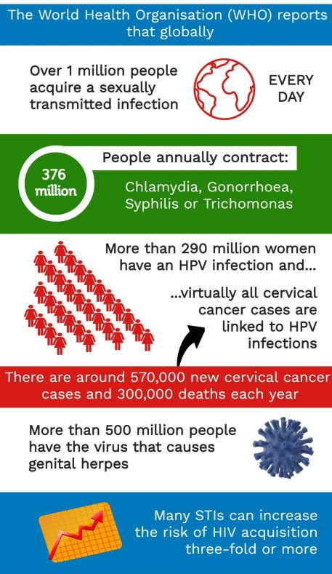
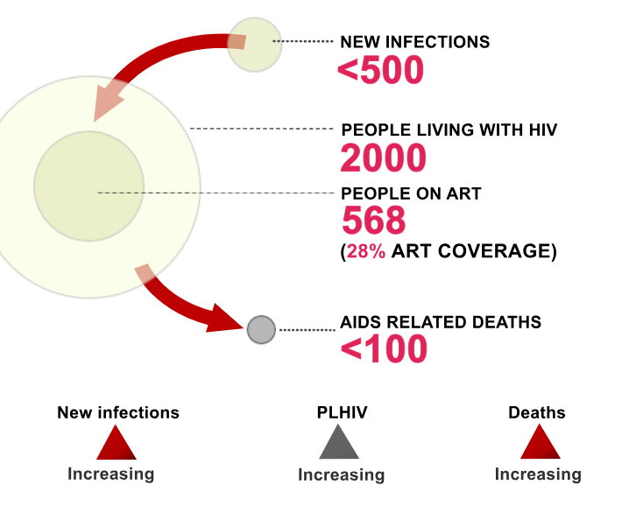
Common Condition
Sexually transmitted infections (STIs)
More than 30 different bacteria, viruses and parasites are known to be transmitted through sexual contacts

Slide 4
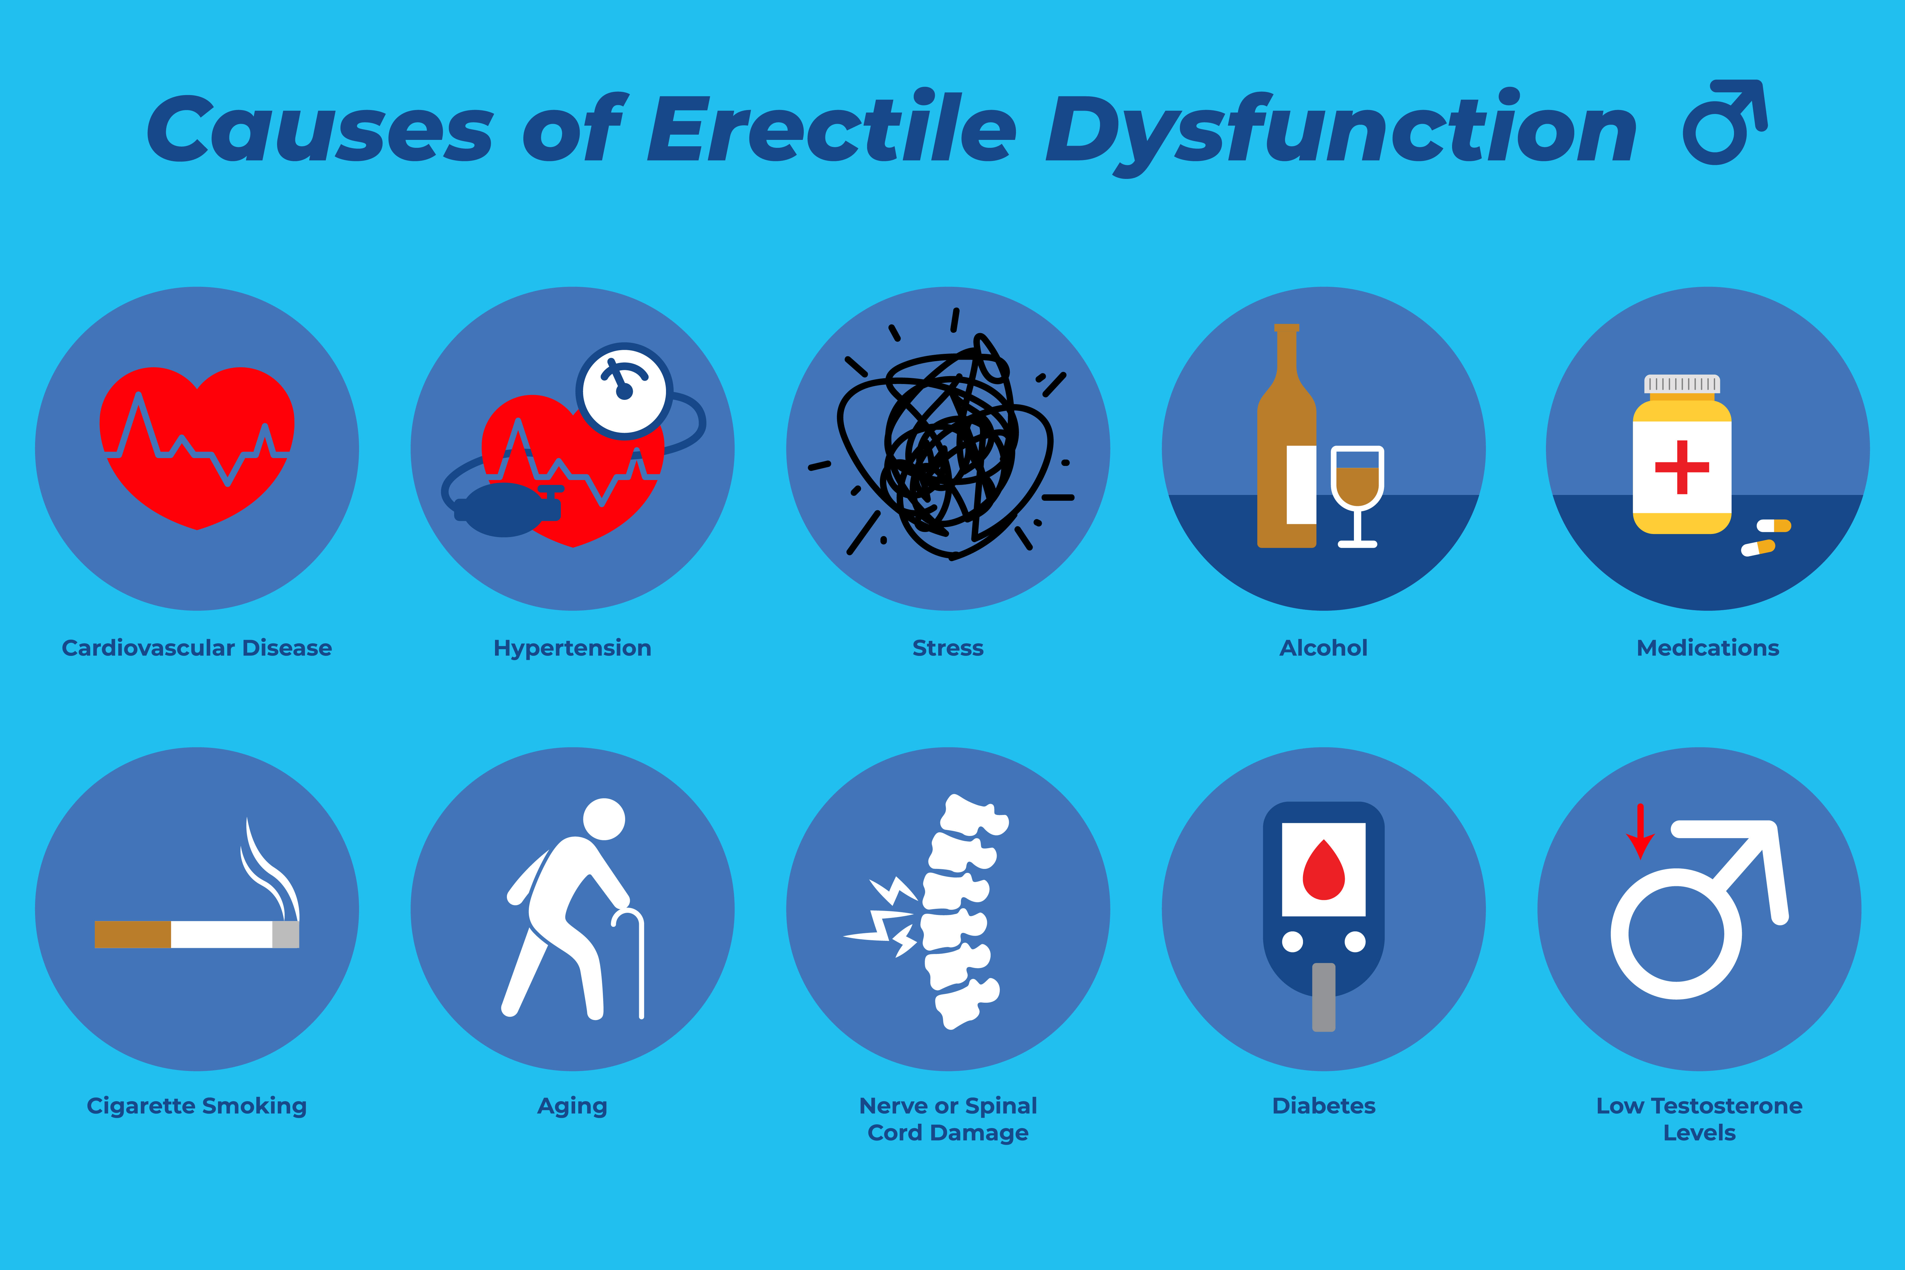
Common Condition
Erectile Dysfunction
Erectile dysfunction (ED) can be an indicator of other health conditions, such as heart disease, diabetes, or hormone imbalances.
It's essential to remember that there's no shame in experiencing sexual health problems.

Slide 5
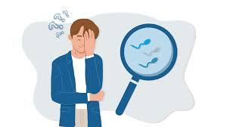
Common Condition
Male infertility
Up to 1 in 3 infertility cases may involve male infertility.
Many factors can contribute to male infertility, including:
  Low sperm production
  Anatomy
  Testicular trauma
  Genetic or immune diseases

Slide 6
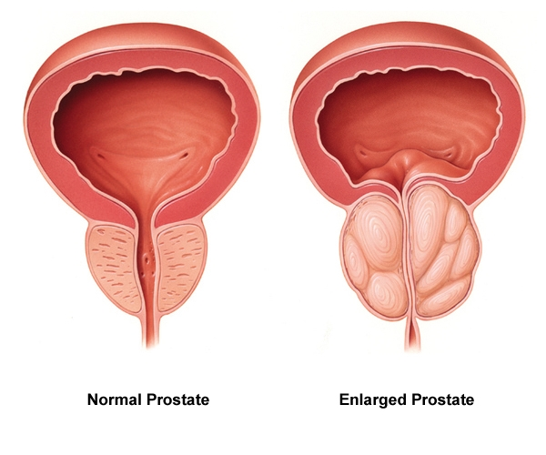
Prostate- BPH/ cancer
The prostate is a gland within the male reproductive system. It is located below the bladder and in front of the rectum, and wraps around the upper part of the urethra, which carries urine out of the body.
Symptoms of a problem include:
  Weak or slow urinary stream
  Incontinence
  Pain when urinating
  Feeling as if your bladder is never completely empty
  Difficulty starting urination
  Frequency and/or urgency to urinate
Notes:
50% of men between the ages 50-60 and 90% of men above the age of 80.

Slide 7
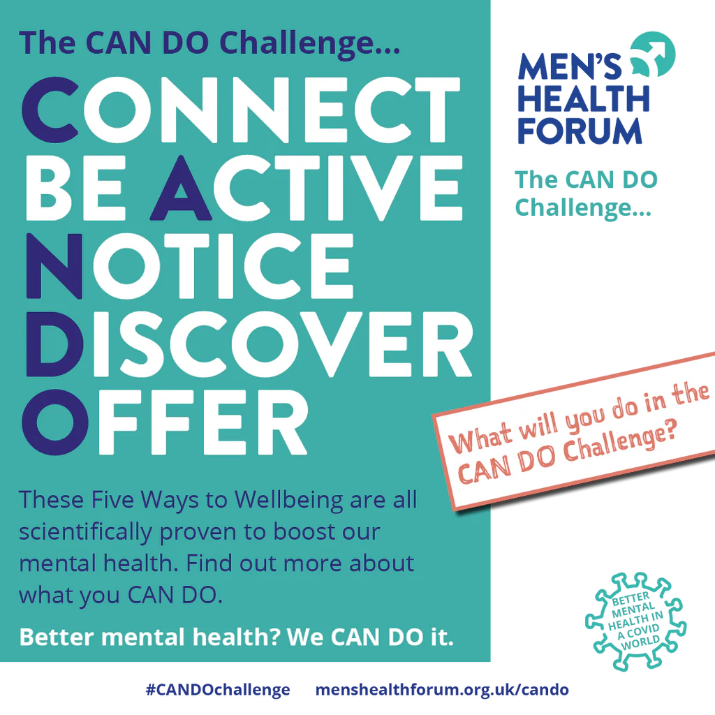
Mental Health
Mental health issues among men are often underestimated and neglected.
Men are less likely to seek help for depression, anxiety, and other mental health conditions, in part due to societal expectations and stigma.
The narrative that men should always be "strong" and shouldn't express emotions can be damaging.
Mental health is just as important as physical health, and seeking help when struggling is a sign of strength, not weakness.
Notes:
40% ED cases are considered psychogenic
C – Connect with friends and family
A – Be active – exercise
N – Notice the environment around you
D – Discover – learn something new everyday – read a book
O – offer your help to others.

Slide 8
“The most important sex organ is not below a man’s waist; it’s sitting on their shoulders.”
Michael O’Leary, MD, MPH
Urologic Surgeon
Mass General Brigham

Slide 9
Why do men not have a Health Help Seeking Behavior?
Social Stigma and Gender Norms - Traditional masculine norms often emphasize strength, self-reliance, and stoicism. Seeking help may be perceived as a sign of weakness or vulnerability, leading men to avoid addressing their health concerns.
Fear of Judgment - Men may fear being judged or stigmatized for discussing intimate or sensitive topics like sexual health
Lack of Awareness - Some men may not be fully aware of the importance of regular health check-ups or may underestimate the significance of symptoms they are experiencing. Perceive it’s a regular process of aging.
Mistrust of Healthcare Providers - Negative past experiences with healthcare providers, perceived discrimination, or a lack of trust in the healthcare system. Believe that there is no treatment available.
Barriers to Access - Factors such as cost, lack of insurance, transportation issues, and long wait times for appointments can serve as practical barriers
Minimization of Symptoms - Men may downplay or ignore symptoms of health conditions, including those related to sexual health, assuming that the issues will resolve on their own.
Cultural and Religious Beliefs - Cultural norms and religious beliefs may influence men's attitudes towards seeking help for sensitive health issues. Some cultural beliefs may discourage open discussion of sexual health topics

Slide 10
Breaking the Taboo – Encouraging Sexual Health Help Seeking Behavior
This requires a multifaceted approach that addresses barriers and promotes a positive attitude towards healthcare
Promote Health Awareness
  Raise awareness about common men's health concerns, including sexual health issues, and the impact they can have on overall well-being.
  Education on Importance of Regular Checks
Destigmatize Help-Seeking
  Challenge stereotypes and misconceptions around masculinity and seeking help for health
Empower Through Knowledge
  Empower men with knowledge about symptoms to watch for, risk factors to be aware of, and when to seek medical advice.
  Education System to cater for such information regarding men's health.
Foster Trust and Communication
  Encourage positive doctor-patient relationships built on trust, respect, and open communication

Slide 11
Breaking the Taboo – Encouraging Sexual Health Help Seeking Behavior
Offer Convenient and Accessible Care
  Address practical barriers, such as cost, transportation, and scheduling, to make it easier for men to seek medical help
Engage in Community Outreach
  Conduct health screenings, workshops, and awareness campaigns in community settings to reach men where they are
  Collaborate with local organizations, workplaces, and community leaders to promote men's health
Leverage Peer Support
  Encourage men to talk to their peers, friends, or family members
  Share personal stories and testimonials from men who have sought help to inspire

Slide 12
To start…
Make men sexual health clinic more accessible.
Integrate men sexual health in formal education system
Integrate men sexual health screening as part of outreach programs – (public health and NGOs)
Promoting proactive approach to health – medical insurance, regular checks
Integrate self-care in daily life – use MEN

Slide 13
Vinaka!
Happy to assist with any queries!

