Slide 1
Gut Microbiome and Childhood developmental Milestones
Dr Zen Min Low
Fellow FCGP/WFFCGP Chair
MBBS(USP). PGDipFM(Monash).

Slide 2
Hippocrates stated that (22)
“Death sits in the bowels”
and that
“Bad digestion is the root of all evil.”

Slide 3
Contents
Gut Microbiome
Gut Microbiome and Childhood developmental Milestones
Physical growth
Brain growth
Immune system
Liver
Factors influencing Microbiome development throughout childhood
References

Slide 4
Notes:
Trillions of symbiotic microbial organisms live in and on the surface of the human body. They can be found in and on nearly every part of the body, including the gut, brain, ear, skin, nose, the oral, gastrointestinal, respiratory, urinary and vaginal tracts and the bloodstream. Their genes are now thought to contribute more to human survival than the genes of the human. Such genes, the human microbiome, are, for example, pivotal to the process of aging, digestion, the immune system, the modulation of the central nervous system, and a person’s mood and cognitive ability. This makes the human microbiome an essential organ in the human body. Without it the human body cannot function.
Microbes have always been an essential part of human life. The co-
evolution between the human host and microbes has established
a mutualistic symbiosis in which the host provides a hospitable
environment and nutrients for the microbiota, while the micro-
biota exerts substantial influence on the host during homeostasis
and disease

Slide 5
Superorganism- human + microbiome

Slide 6
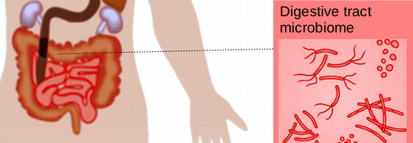
Gut Microbiome
- 3.8 × 10^13 microbes , more cells than human total cells (3.0 × 10^13)
- Density= 10¹¹ to 10¹² /ml, colon one of the most densely populated microbial habitats known on earth
encodes > 3 million genes producing thousands of metabolites, human genome consists of approximately 23,000 genes
Notes:
Refers to the entire microbial community that populates the mammalian gastrointestinal (GI) tract, with the majority residing in the colon
Mic genes evolve more for human survival that human genes

Slide 7
Gut Bacteria types
Based on their role to human health, this microbial community can be grouped into three categories, namely
healthy bacteria (probiotics),
unhealthy bacteria (pathogenic bacteria), and
health neutral bacteria (neutral bacteria)
Notes:
Neutral bacteria can switch from probiotics to pathogenic bacteria depending on the surrounding environment or the host health status.
There are five major phyla for the human gut microbiota, namely Firmicutes,
Bacteroidetes, Actinobacteria, Proteobacteria, and Verrucomicrobe, with the two dominating phyla, Firmicutes and Bacteroidetes, representing 90% of the gut microbiota [ 3 ]. Some
bacteria termed “pathobionts” can become pathogenic under specific conditions. For
example, members of the phylum Proteobacteria belong to “pathobionts”, and a bloom
of them is seen in inflammatory bowel disease (IBD

Slide 8
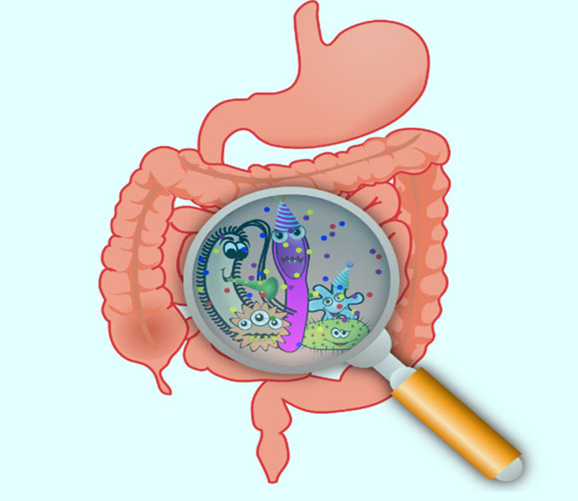
THE HUMAN MICROBIOME HAS AN INFLUENCE ON THE 4 BROAD AREAS OF IMPORTANCE TO HEALTH (1,2,3)
Nutrition
Immunity ( autoimmune diseases (SLE, Rheumatoid arthritis, inflammatory bowel disease), atopy, asthma, food allergies)
Behavior and mood (Autism, ADHD ,Neurodegenerative diseases of aging ( AD, depression)
Diseases (obesity, diabetes, colorectal cancers, heart diseases)
Notes:
Traditionally, knowledge of the human GI tract functions to digest foods and uptake nutrients. It also protects from pathogen infection as well as maintains immune tolerance. Undigested foods reach the colon and serve as substrates for bacterial metabolism. Carbohydrates, proteins, and fats
Vitamin K and B vitamins, including biotin

Slide 9
Figure 1. Impacts of foods and nutrition on the microbiota-host interactions in the gut (12)

Slide 10
Geographical layers of intestinal (colon) defence mechanisms
Notes:
The epithelial barrier consists of multiple layers of defence, which function both simultaneously and subsequently with each other. Geographically, from the outside (lumen) towards the inside (lamina propria): (1) the outer most layer consists of mucus which acts as a physical barrier,is 4–5 times in volume, which creates a habitat for the commensal bacteria (2) . The inner mucus layer is continuously
renewed every 1–2 h in murine colonic tissue and that is further reinforced biochemically with antimicrobial peptides and immunoglobulin A. (3) Intestinal epithelial cells form a single-cell layer of protection which is interspersed with intraepithelial lymphocytes and held together by tight junction proteins such as claudins, occludins, and zonulae occudens. (4) Within intestinal crypts are intestinal epithelial stem cells, which are key in replenishing the epithelial surface. (5) Beyond the epithelial layer is the lamina propria, where most of the intestinal mucosal immune system resides which is densely populated with leukocytes that serve to back up the innate immune defences and provide immunological memory against future repeated insults. Note that this graphic does not dictate the order of importance but rather serves to visualise the multiple layers of defence that make up the epithelial barrier.
. Once the inner mucus layer is lost or becomes
penetrable to bacteria, a large number of bacteria will reach the epithelial cells and trigger
inflammation. Thus, a penetrable inner mucus layer allowing large quantities of bacteria
to reach the epithelial cells is a common mechanism for all mouse models of colitis and
patients with active ulcerative colitis
Abbreviations: Immunoglobulin A, IgA; intraepithelial lymphocyte, IEL; intestinal epithelial cell, IEC; intestinal epithelial stem cell, IESC.

Slide 11
Figure 2: Stages of intestinal microbial colonization in the infant and child (13)
Notes:
Microbiome maturity happens by 3 years of age

Slide 12
Childhood development
Physical development refers to strength and physical skills.
Cognitive development involves thinking and problem-solving.
Language development refers to communication and understanding.
Social-emotional development affects how children interact with others and process feelings.

Slide 13
Gut Microbiome and Childhood developmental Milestones
Physical Growth
Physical growth of children is defined as an irreversible and constant increase in body size (length or height and weight) and in the size of organs (10)
Obesity
Stunting
Notes:
gut microbiome plays key roles in regulating energy harvest from nutrients, growth hormone signaling, and prevention of pathogen colonization.

Slide 14
Figure 3. Selected mechanisms through which gut microbes affect the process of growth in children (11)
Notes:
Food components and endogenous metabolites of nutrients directly modulate the gut epithelial barrier and mucosal immune system. Diet also determines microbiota-accessible
nutrients, which play a critical role in the gut microbiota ecology. The interaction between the gut microbiota with host epithelium and the mucosal immune system determines intestinal homeostasis.
IEC, intraepithelial lymphocytes; AMP, antimicrobial peptides; sIgA, secretory immunoglobulin A; DCs, dendritic cells; SCFAs, short-chain fatty acids; BCFAs, branched-chain fatty acids

Slide 15
Gut Microbiome and Childhood developmental Milestones
Charbonneau et al. (15)
showed the mechanisms through which HMOs interact with gut microbes to regulate growth.
“The content of breast milk HMOs from mothers in two Malawian birth cohorts was characterized. One cohort included infants who exhibited healthy growth, whereas the other cohort included infants who were severely stunted. The mothers of the stunted infants exhibited a significantly lower abundance of HMOs in breast milk at six months”

Slide 16
Gut Microbiome and Childhood developmental Milestones
Malawian twin pairs discordant for kwashiorkor by Smith et al.
“fecal microbiota were transplanted from several discordant pairs into gnotobiotic mice
It was noticed that mice that received transplants from children with kwashiorkor and were fed the Malawian diet experienced
significant weight loss and disturbances in carbohydrate and amino acid metabolism”

Slide 17
Studies in mouse models by Ronan et al. (17)
“have shown that transplanting fecal matter from obese subjects (human or murine) leads to an increase in total body fat when compared to recipients of fecal matter from lean subjects.

Slide 18
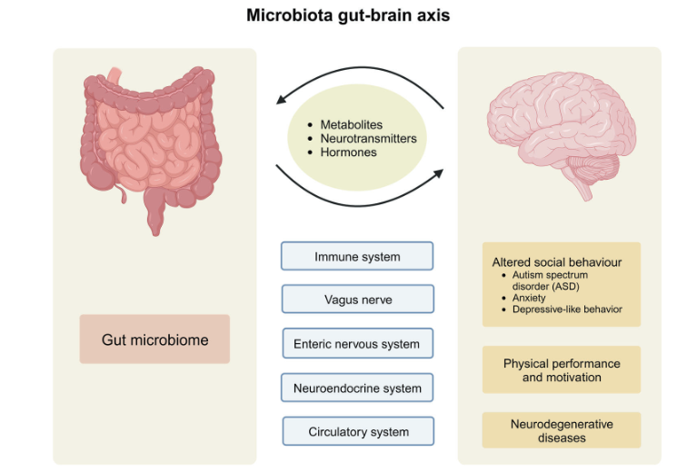
Gut Microbiome and Childhood developmental Milestones
Brain
Development
(15)
Notes:
2nd brain. Relates to the complex network of nerve cells ( same as spinal cord) and the 300 plus neurotransmitters present ( same as the brain)

Slide 19
Gut Microbiome and Childhood developmental Milestones ( Brain)
Bioactive metabolites are produced by microbiota in the gut and can function as neurotransmitters. Serotonin, dopamine, noradrenaline, acetylcholine and GABA are produced by gut microbiota (3)
gut provides approximately 95% of total body serotonin, most of which exists in plasma and probiotics improve depressive symptoms (5)

Slide 20
Victoria Ronan and Group (5) a summary of Studies of Gut Microbiome and Childhood Brain development
Lu et al ,germfree mice noted
“when inoculated with fecal matter from preterm babies with poor NICU growth, demonstrated delayed brain development in neuronal differentiation, oligodendrocyte differentiation, and myelination when compared to recipients of donors with appropriate growth. The microbiota from infants with low growth also resulted in alteration of neurotransmitter pathways, increases in neuroinflammation and decreased levels of IGF-1”

Slide 21
2) “ In human studies,
dysbiosis has been associated with attention deficit hyperactivity disorder (ADHD),lower cognitive performance in receptive and expressive language domains, and an increase in fear reactivity and oppositional behavior”

Slide 22
3) A case control study comparing Chinese children with ADHD to healthy controls found those with ADHD have lower Faecalibacterium and Veillonellaceae, while Enterococcus and Odoribacter were significantly increased .
4)Two large human studies have noted associations between gut microbiome and temperament in infants, where dysbiosis increased the traits that may precede psychopathology, such as in depression or anxiety

Slide 23
5) In a study conducted by Carlson et al
the microbiomes of 89 one-year-old infants were analyzed along with Mullen Scales testing for neurodevelopment. Alpha diversity at age one was associated with poorer scores on an Early Learning Composite score, visual reception, and expressive language scales at age two.

Slide 24
6) A recent study of Serbian children
“comparing patients with neurodevelopmental disorders to typically developing counterparts found those with neurodevelopmental disorders to have less butyrate producing taxa and an increase in clostridium like species”

Slide 25
7) In an open label trial, Kang et al
“established that children with
autism who received fecal transplantation showed improvements in social skills and adaptive
Behaviors”

Slide 26
8) studies have reported mechanisms of dysregulation of dopamine, serotonin, and norepinephrine .
Sharon et al demonstrated that germfree mice that underwent fecal matter transplant from human donors with ASD displayed ASD-like behavior, while the mice that received transplants from typically developing individuals did not exhibit any change.

Slide 27
Gut Microbiome and Childhood developmental Milestones
Immune development
-70 to 80 % of immune Cells (4)
-Infancy and early childhood is a key time period for education of the immune system and establishing tolerance to commensal organisms
Notes:
Mother’s breast milk offers important initial immune protection to the infant through passive transmission of immunoglobulins, microbes, and prebiotics .
Oligosaccharides function as prebiotics to maintain the growth of specific bacteria such as Bifidobacteria. As the infant starts eating solid foods, the microbiome evolves toward an adult one

Slide 28
Gut Microbiome and Childhood developmental Milestones
Food allergies, atopy, allergy rhinitis and asthma are linked to dysbiosis (20,21)
GI-associated autoimmune disease=Inflammatory bowel disease (Crohn disease and ulcerative colitis) and extra GIT autoimmune disease ( Rheumatoid arthritis and type 1 diabetes mellitus (18)
Notes:
The real cause of food allergy is still unclear, but it is widely accepted that alterations in the gut bacterial levels or diversity is the leading reason for the rise of food allergy incidence (Savage et al., 2018). Several landmark studies from the past few years have reported a microbiome signature in food allergy, especially in children, suggesting that dysbiosis in early life may be predictive of disease persistence.
The immune system plays a vital role in keeping the body healthy by providing a fine balance between the elimination of invading pathogens and the maintenance of tolerance to healthy self-tissue. However, in the case of patients with autoimmune disorders, the mechanism to maintain self-tolerance fails and the result is that the immune system mistakenly attacks and destroys healthy self-tissue

Slide 29
Gut Microbiome and Childhood developmental Milestones
Studies with germ-free (GF) mice
“indicated a direct link between GI microbiome and airway inflammation. Compared to specific pathogen–free (SPF) group, the GF mice with allergic airway inflammation presented elevated number of infiltrating lymphocytes and eosinophils. And this evaluation could be restored by recolonization of feces from SPF mice to GF mice” (5)

Slide 30
commensal microbes play a major role in shaping the population of Foxp3+CD4+T regulator cells in the colon. his is a subset of CD4+CD25+ T cells expressing the transcription factor Forkhead box P3 (Foxp3), which could suppress spontaneous multi-organ autoimmunity, including gastrointestinal inflammation induced
by CD4+CD25− T cells (5)

Slide 31
Gut Microbiome & Liver (9)

Slide 32
Factors influencing Microbiome development throughout childhood

Slide 33
How to optimize the Diversity= High Fibre
High fiber diet -WHO recommendation (6)
2–5 years old, at least 15 g per day
6–9 years old, at least 21 g per day
10 years or older, at least 25 g per day
Fermented Vegetables
Sauerkraut/pickles, Kimchi,
Notes:
Cup of beans = 15 g , Cup of mix vegetables= 5g, 1 piece of fruit is 3g, small handful of nuts= 3g, fist size of brown rice=3.5 g ( 7.5 g + 15g + 6g +3g + 3.5g= 35g )
WHO
2–5 years old, at least 15 g per day
6–9 years old, at least 21 g per day
10 years or older, at least 25 g per day.
A recent human study showed that a diet rich in fermented foods leads to increased microbial diversity and decreases in numerous markers of inflammation [ 10 ]

Slide 34
How to optimize the Diversity= Low Fat
“ high-fat diet leads to reduced diversity of the gut microbiota in humans and rodents compared with low-fat diets, regardless of the fat source being lard, milk, safflower oil, or palm oil” (12)
“High dietary milk fat (rich in saturated fatty acid), but not safflower oil (rich in n-6 polyunsaturated fatty acids), induced a bloom of a sulfate-reducing microbe Bilophia wadsworthia. Milk fat increased the incidence of colitis with typical Th1 inflammatory response in genetically susceptible IL10−/− mice but not in wild-type mice”

Slide 35
How to optimize the Diversity = Protein (12)
recommended = 0.6–0.8 g/kg/d
LPD- immune defects and intestinal inflammation ( mice, a protein-free diet worsens DSS-induced colitis). Tryptophan (an essential amino acid) is a key regulator of gut immunity.
HPD-90 % meat & 70–90 plant base.
Undigested protein is mainly fermented in the distal colon and produces far more complex metabolites than carbohydrate fermentation
-Processed meat exclusion in Crohn’s Disease Exclusion Diet
Notes:
42-56g Protein = 1g=4cal -.6 to .8/kg/day ( 1 egg= 5g of protein , 100g fish= 21g protein, 100g chicken/beef=27g protein, )
chicken meat is better than soy protein at maintaining the gut mucus barrier.
Long-term (90-day) soy protein intake in growing rats leads to increased mRNA levels of LBP and CD14 in the liver compared with casein, beef,
and chicken as protein sources, indicating increased levels of bacterial endotoxins
HPD= including SCFAs, branched-chain fatty acids, carbon dioxide,hydrogen, hydrogen sulfides, ammonia, phenols, and indole derivatives (hydrogen sulfides and ammonia) are toxic compounds and could be potentially detrimental to colonic epithelium at excessive amounts
Processed meat = contains high amounts of sulfated amino acids, which are fermented by sulfate-reducing
bacteria to generate hydrogen sulfide (H2S); therefore, processed meat is excluded in the
Crohn’s Disease Exclusion Diet

Slide 36
How to optimize the Diversity
Food Components Negatively Influence the Gut Microbiome and Intestinal Health (12)
food additives (CMC(E469/466) and P80 (E433)
alcohol
high sugar intake (IBD )
Notes:
food additives and alcohol, can influence the intestinal barrier negatively and lead to a leaky gut which potentially facilitates the translocation of a large number of gut bacteria, pathogen infection, and subsequent gut inflammation
two commonly used
emulsifiers, carboxymethylcellulose (CMC) and polysorbate-80 (P80), administered in mice at relatively low concentrations, resulted in decreased mucus thickness by more than
half and microbiota encroachment [ 26 ]. CMC and P80 did not change the total levels of faecal bacteria but dramatically changed the microbiota composition, including reducing
Bacteroidles and increasing Ruminoccus gnavus, which is mucolytic. In IL-10−/− mice, both CMC and P80 induced a marked reduction of microbial diversity, highly increased
Verrucomicrobial phyla (Akkermansia muciniphila), and increased Proteobacteria. Emulsifier- treated mice have much higher colitis incidence and severity, indicating the emulsifiers
increase the pro-inflammatory potential in susceptible subjects
CMC/P80 =including ice cream, mayonnaise, and beverages. It is also used extensively in gluten-free and reduced-fat food products.^{[13]}
High sugar intake is a hallmark of the Western diet
High dietary sugars markedly induce an increase in the abundance of the mucus-degrading bacteria Akkermansia muciniphila and Bacteroides fragilis, which leads to erosion of the colonic mucus layer

Slide 37
Mindfulness in eating (7)
Notes:
sources of stress vary—e.g., stress may be physical (e.g. manual labor, sleep deprivation, extreme exertion), chemical (e.g. alcohol, drugs, pesticides, pollutants), mental (e.g. anxiety, worry, long work hours), emotional (e.g. anger, fear, sadness), and nutritional (e.g. food allergies, micronutrient deficiencies)

Slide 38
References
1) Robertson, R. C., Manges, A. R., Finlay, B. B. & Prendergast, A. J. The human microbiome and child growth—first 1000 days and beyond. Trends Microbiol 27, 131–47. (2019).
2) Ruairi C. Robertson, Thaddeus J. Edens, Lynnea Carr, Kuda Mutasa, Ethan K. Gough,Ceri Evans,Hyun Min Geum, Iman Baharmand, Sandeep K. Gill, Robert Ntozini, Laura E. Smith, Bernard Chasekwa, Florence D. Majo, Naume V. Tavengwa, Batsirai Mutasa, Freddy Francis, Joice Tome, Rebecca J. Stoltzfus, Jean H. Humphrey, Andrew J. Prendergast & Amee R. Manges. The gut microbiome and early-life growth in a population with high prevalence of stunting. Nature, Published: 14 February 2023
3) Victoria Ronan1, Rummanu Yeasin1,2, Erika C. Claud1,Childhood Development and the Microbiome: The Intestinal Microbiota in Maintenance of Health and Development of Disease During Childhood Development. Gastroenterology. 2021 January ; 160(2): 495–506. doi:10.1053/j.gastro.2020.08.065.
4) Selma P. Wiertsema , Jeroen van Bergenhenegouwen , Johan Garssen , and Leon M. J. Knippels .The Interplay between the Gut Microbiome and the Immune. System in the Context of Infectious Diseases throughout Life and the Role of Nutrition in Optimizing Treatment Strategies. Review aerticle , nature
5) Jeremy Appleton. The Gut-Brain Axis: Influence of Microbiota on Mood and Mental Health. Integr Med (Encinitas). 2018 Aug; 17(4): 28–32
6) https://www.google.com/url?sa=t&source=web&rct=j&opi=89978449&url=https://www.who.int/news/item/17-07-2023-who-updates-guidelines-on-fats-and-carbohydrates&ved=2ahUKEwidlo3FssOHAxUBzjgGHTYHIlAQFnoECBwQAQ&usg=AOvVaw3l6djGeURwh0zizdAWwsbb

Slide 39
References
7) Christine E. Cherpak, DCN-c, CIHC. Mindful Eating: A Review Of How The Stress-Digestion-Mindfulness Triad May Modulate And Improve Gastrointestinal And Digestive Function
8) Emanuele Rinninella, Pauline Raoul,Marco Cintoni, Francesco Franceschi, Giacinto Abele Donato Miggiano,Antonio Gasbarrini,and Maria Cristina Mele. What is the Healthy Gut Microbiota Composition? A Changing Ecosystem across Age, Environment, Diet, and Diseases. Microorganisms. 2019 Jan; 7(1): 14
9) Katherine JP Schwenger,1,2 Nayima Clermont-Dejean,1 and Johane P. Allard . The role of the gut microbiome in chronic liver disease: the clinical evidence revised. JHEP Rep. 2019 Sep; 1(3): 214–226
10) Balasundaram, P.; Avulakunta, I.D. Human Growth and Development. In StatPearls; StatPearls Publishing: Treasure Island, FL, USA, 2021
11) Magdalena Durda-Masny * , Joanna Ciomborowska-Basheer, Izabela Makałowska and Anita Szwed . The Mediating Role of the Gut Microbiota in the Physical Growth of Children. Review.Life.
12) Ping Zhang . Influence of Foods and Nutrition on the Gut Microbiome and Implications for Intestinal Health. Review. International science of molecular sciences.
13) Gut Microbiota Development: the Importance of Prebiotics & Probiotics in Early Life. Nursing , clinical review. May 1, 2019
14) Smith, M.I.; Yatsunenko, T.; Manary, M.J.; Trehan, I.; Mkakosya, R.; Cheng, J.; Kau, A.L.; Rich, S.S.; Concannon, P.; Mychaleckyj,
J.C.; et al. Gut Microbiomes of Malawian Twin Pairs Discordant for Kwashiorkor. Science 2013

Slide 40
References
15) Charbonneau, M.R.; O’Donnell, D.; Blanton, L.V.; Totten, S.M.; Davis, J.C.C.; Barratt, M.J.; Cheng, J.; Guruge, J.; Talcott, M.; Bain,J.R.; et al. Sialylated Milk Oligosaccharides Promote Microbiota-Dependent Growth in Models of Infant Undernutrition. Cell .2016
16) Jian Sheng Loh , Wen Qi Mak , Li Kar Stella Tan, Chu Xin Ng , Hong Hao Chan, Shiau Hueh Yeow , Jhi Biau Foo , Yong Sze Ong ,Chee Wun How and Kooi Yeong Khaw . Microbiota–gut–brain axis and its therapeutic applications in neurodegenerative disease
17) Turnbaugh PJ, Ley RE, Mahowald MA, Magrini V, Mardis ER, Gordon JI. An obesity-associated gut microbiome with increased capacity for energy harvest. Nature. 2006 12 21
18) Hsin-Jung Wu, and Eric Wu. The role of gut microbiota in immune homeostasis and autoimmunity. Gut Microbes. 2012 Jan 1; 3(1): 4–14
19) Herbst T., Sichelstiel A., Schär C., Yadava K., Bürki K., Cahenzli J., et al.. (2011). Dysregulation of Allergic Airway Inflammation in the Absence of Microbial Colonization. Am. J. Respir. Crit. Care Med. 184 (2), 198–205.
20) Pei Han,Jian-Qing Gu, Li-Sha Li, Xue-Yan Wang, Hong-Tian Wang, Yan Wang, Christopher Chang, and Jin-Lyu Sun
The Association Between Intestinal Bacteria and Allergic Diseases—Cause or Consequence? Front Cell Infect Microbiol. 2021
21) Yiwei wang, tian Liu, Zihao, Lin Wang, Jinpao Hou, Mai Shi, Stephen kwok. Inestigating casual relationships between the gut microbiota and allergic diseases. A mendelian randomization study. Front. Genet. 12th April 2023.
22) Inna Sekirov,Shannon L. Russell,L. Caetano M. Antunes, andB. Brett Finlay. Gut Microbiota in Health and Disease
01 JUL 2010. American Physiology society. Review. Vol 90.no 3.

